Slide 1

MAT-1.2.2-T009-D001 Database population AS and HHFM
WPMAT EDDI Monitoring Meeting
3-4 November 2016, Garching, Germany
Ermile Gaganidze (Author, KIT)

Slide 2

MAT-1.2.2-T009: Database Population- Advanced Steels and High Heat Flux Materials (KIT)
Objectives:
Develop Advanced Steels (AS) database
Develop High Heat Flux Materials (HHFM) database
Interact with relevant WPMAT sub-projects in support of EDDI database and MPH developments
Develop missing AS and HHFM database templates
Qualify data integrity (verify the data with respect to the completeness of the provided information; review against EUROFUSION EDDI database quality thresholds)
Deliverable:
Summary overview report on Database Population - Advanced Steels and High Heat Flux Materials for year 2016 (MAT-1.2.2-T009-D001)
Acceptance Criteria:
The task shall be carried out along the lines defined in the technical specification

Slide 3
AS Database Development of Fatigue Crack Growth Template
IDM reference 2MLK64

Slide 4
AS Database Population
Compilation of the data generated in MAT-AS sub-project within 2015
MAT-AS data provided in EDDI database templates
Verification of the completeness of the provided data & Filling the missing information via interaction with the PIs of relevant tasks
Property/Information | Data source | No. of records
Composition of advanced RAFM steels | SCK-CEN, KIT | 20
Composition of advanced ODS RAFM steels | CEIT | 15
Product information of advanced RAFM steels | SCK-CEN | 41
Product information of advanced ODS RAFM steels | CEIT | 19
Hardness of advanced RAFM steels | KIT | 120
Impact properties of advanced RAFM steels | SCK-CEN | 23
Tensile properties of advanced RAFM steels | SCK-CEN | 28
Not all the data produced within 2015 is provided by Research Units
Participation in AS monitoring meeting, 22 June 2016, ENEA-Frascati

Slide 5
AS Database
WP-MAT AS: 9Cr-RAFM steels with optimized composition and TMT
Compilation of the data and comparison with average and minimum curves from MPH
Notes:
L=28mm; d=3mm
Multiple rolling passes;

Slide 6
HHFM database population
Compilation of the data generated in MAT-HHFM sub-project within 2015
MAT-HHFM data provided in HHFM templates
Verification the completeness of the provided data & Filling the missing information via interaction with the PIs of relevant tasks (partly finished)
Transferring the mechanical properties data into the EDDI database templates
HHFM Data transferred into EDDI database templates
Property/Information | Data source | No. of records
Bending properties of W alloys (W-30CuCrZr, W-30Cu, W-Cr10Ti2, W-15Ta) | UPM | 31
Tensile properties of W alloys (W-30CuCrZr, W-30Cu, W-Cr10Ti2, W-15Ta) | UPM | 14
Fracture Toughness of W alloys (W-30CuCrZr, W-30Cu, W-Cr10Ti2, W-15Ta, pure-W, WVM-foil) | UPM, ÖAW-ESI | 60
Impact properties of W laminates (W-Cu, W-V) | KIT | 11
Thermo-physical properties of W alloys (WCr10ti2-HIP, WCr10Ti2-HIP+1600C, WCr15) | CEIT | 30
Notes:
W10PF: 0.7µm powder + source of carbon (phenol formaldehyde resin)
W10G: 0.7µm powder + source of carbon (graphene)

Slide 7
HHFM database population
HHFM Data kept in original HHFM templates
Property/Information | Data source
Composition, fabrication route of reinforced W alloys (W-Si-C, W10PF, W10G, SiCf/W-Ti) | JSI
Composition, fabrication route of PIM W (W, W-1TiC, W-2Y₂O₃, W-2La₂O₃, W-2TaC) | KIT
Composition, fabrication route of W laminate (W-Cu, W-V) | KIT
Composition, fabrication route of pure, alloyed and rigid fillers powders (Cu-20Ti) | CIEMAT-URJC
Fabrication route of W-Eurofer brazed joints (+Vickers HV0.1 hardness) (W substrate + Eurofer substrate + Cu-20Ti filler) | CIEMAT-URJC
Composition, manufacturing of thermal barriers (25WC-75Cu, 50WC-50Cu, 75WC-25Cu) | IST
High Heat Flux testing of tungsten alloys (IGP, PIM-W, W-SiC, W-Cr-Ti) | FZJ
Diversity of applied fabrication routes for different materials makes the development of universal templates complex.
Reasonably such templates should be developed after demonstration of performance level relevant for application under high heat flux loading conditions.
Notes:
W10PF: 0.7µm powder + source of carbon (phenol formaldehyde resin)
W10G: 0.7µm powder + source of carbon (graphene)

Slide 8
MAT-1.2.2-T009: Database Population- High Heat Flux Materials
Impact properties of W-Cu and W-V laminates (KIT)
Fracture-Mechanical properties of W-foils (AW-ESI)

Slide 9
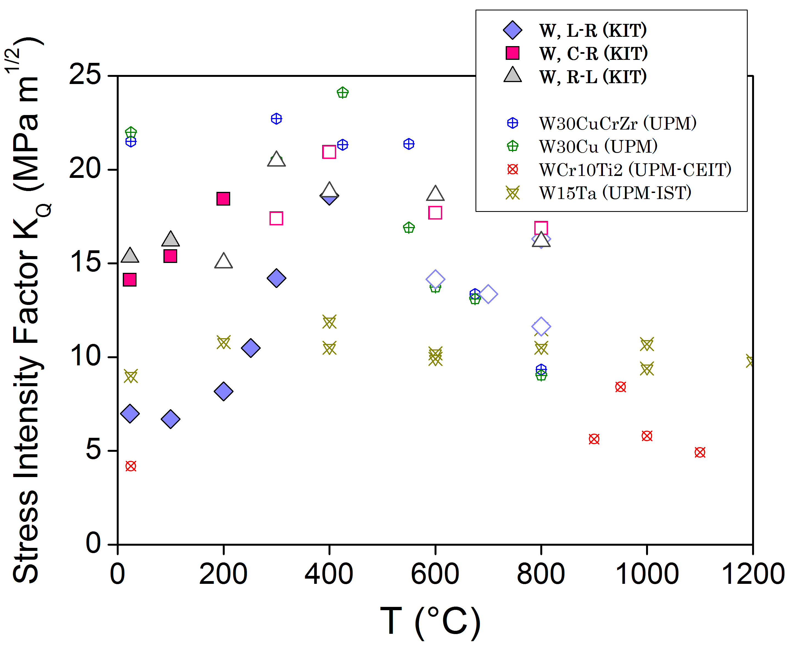
MAT-1.2.2-T009: Compilation and Assessment of Fracture Toughness
KIT data: the test results where LEFM is no more applicable are represented by open symbols. These values give the lower bound of the fracture toughness.
UPM data: no differentiation is done between valid and invalid data as the applicability of LEFM could not be followed.

Slide 10
Summary
Development of the missing database templates
Compilation of the data generated in the MAT-AS and MAT-HHFM sub-projects within 2015
Filling the missing information via contacting the PIs of relevant tasks
Transferring the mechanical properties data on HHFM into the EDDI database templates

Slide 11
Midterm–Review: Objectives-Status for the 5 year period
Objective(s):
Develop EUROfusion database on structural steels and HHFM
Develop and finalize steel and HHFM templates; Provide a supporting glossary
Populate templates with available data from PPPT RUs, literature and external organisations (e.g. F4E, IO)
Interact with relevant WPMAT sub-projects in support of the EDDI database and MPH developments
Achievement and status:
Report the achievements
Finalization of existing database templates & development of new templates
Harmonization of database templates with respect to the key records aiming code qualification of materials
The compilation and review of mechanical properties data on EUROFER97 available in the literature and obtained by RUs; Identification and filling the gaps
Compilation of the data generated in MAT-AS and MAT-HHFM sub-projects within 2015; Identification and filling the gaps
Testing practices (specimen geometries, test standards, …) for tungsten mechanical properties provided

Slide 12
Achievement and status:
Report as well on failures (long-term as important as appearing all time “brilliant”)
Not all data generated within AS is transferred into EDDI database
How far are you wrt to schedule: Activity in line wrt to schedule
Impact on the project
Reference document for EUROFER97 MPH
Interaction with other tasks/work-packages ….
Interact with AS and HHFM sub-projects in support of the EDDI database and MPH developments
Outlook:
Transfer AS and HHFM data into EUROfusion database
Identification and filling the gaps in the database
Challenge
In-time input from the relevant MAT Projects
Harmonization of EUROfusion database with databases of external organizations (e.g. F4E, IO)
Development of data storage and management system (software) & hardware infrastructure (hardware) for enduring database

Slide 13























